Slide 1

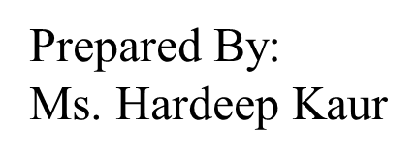
UNIVERSITY INSTITUTE OF ENGINEERING
COMPUTER SCIENCE ENGINEERING
Bachelor of Engineering (Computer Science & Engineering)
Subject Name: STATISTICAL METHODS USING R
Subject Code: 20SMT-460

Slide 2
Mode

Slide 3
Definition: The mode is a measure of central tendency that represents the most frequently occurring value in a dataset. Unlike the mean and median, the mode is not necessarily unique; a dataset may have one mode, more than one mode (multimodal), or no mode at all.

Slide 4
Types of Mode:
Unimodal: A dataset with one mode.
Bimodal: A dataset with two modes.
Multimodal: A dataset with more than two modes.
No Mode: A dataset with no clear mode (all values occur with the same frequency).

Slide 5
Properties:
The mode is not affected by extreme values or outliers.
A dataset can have zero, one, or multiple modes.
In a perfectly symmetrical distribution, the mean, median, and mode are all equal.

Slide 6
Calculation: To find the mode:
For Raw Data:
Identify the value(s) that appear most frequently.
Example: Dataset: 4, 2, 6, 4, 8, 4, 7 Mode = 4 (as it appears most frequently).

Slide 7
For Grouped Data:
Identify the modal class, which is the class interval with the highest frequency.
Example: Class Interval: 10 - 20, 20 - 30, 30 - 40 Frequencies: 5, 8, 12 Modal class = 30 - 40 (as it has the highest frequency).

Slide 8
Examples:
Example 1: Mode for Raw Data
Consider the dataset: 3, 5, 2, 7, 3, 8, 3, 2, 6, 5
To find the mode:
Identify the value(s) that appear most frequently.
In this case, the number 3 occurs most frequently (three times).

Slide 9
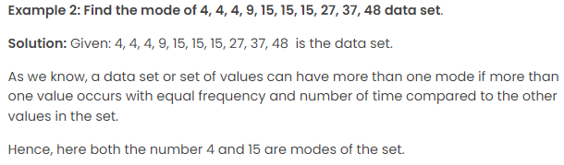

Slide 10
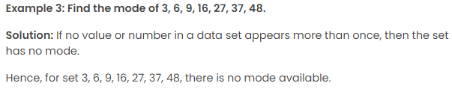

Slide 11
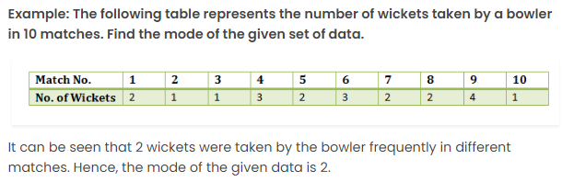

Slide 12
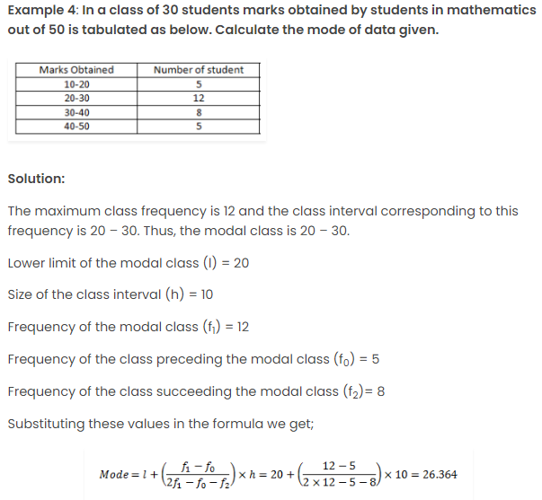

Slide 13
https://www.youtube.com/watch?v=E6jNADpaY2Q&pp=ygUvbWVhc3VyZSBvZiBjZW50cmFsIHRlbmRlbmN5IGFuZCBkaXNwZXJzaW9uIGlpdCA%3D

